Slide 1

Machine Learning
Faculty of Electrical Engineering
Telkom University

Slide 2
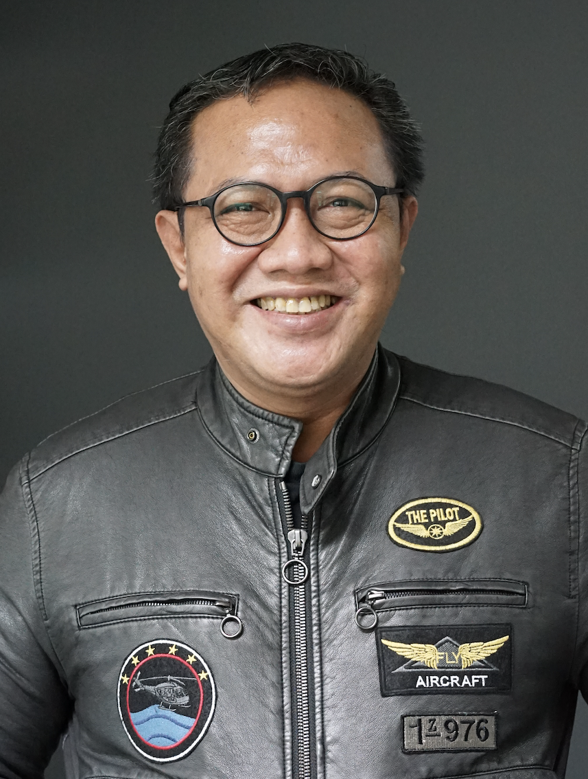
About Me
Dr. Risman Adnan Mattotorang, S.Si, M.Si
University of Indonesia
Microsoft Indonesia
Microsoft Asia Pacific
Samsung R&D Indonesia
Work on: SW, AI, Cloud and IoT

Slide 3
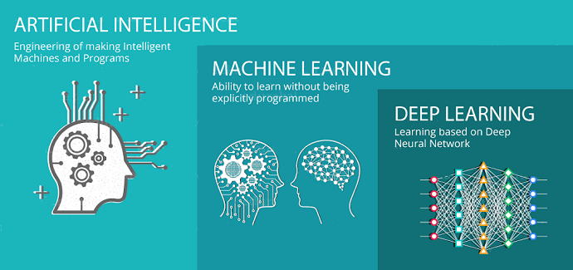
About This Course
We will learn about Machine Learning (ML) including Deep Learning (DL)
The FCP way of learning: Fundamental, Conceptual and Practical
After the course you will be able to work with ML and DL frameworks as Data Scientists or AI Engineers

Slide 4
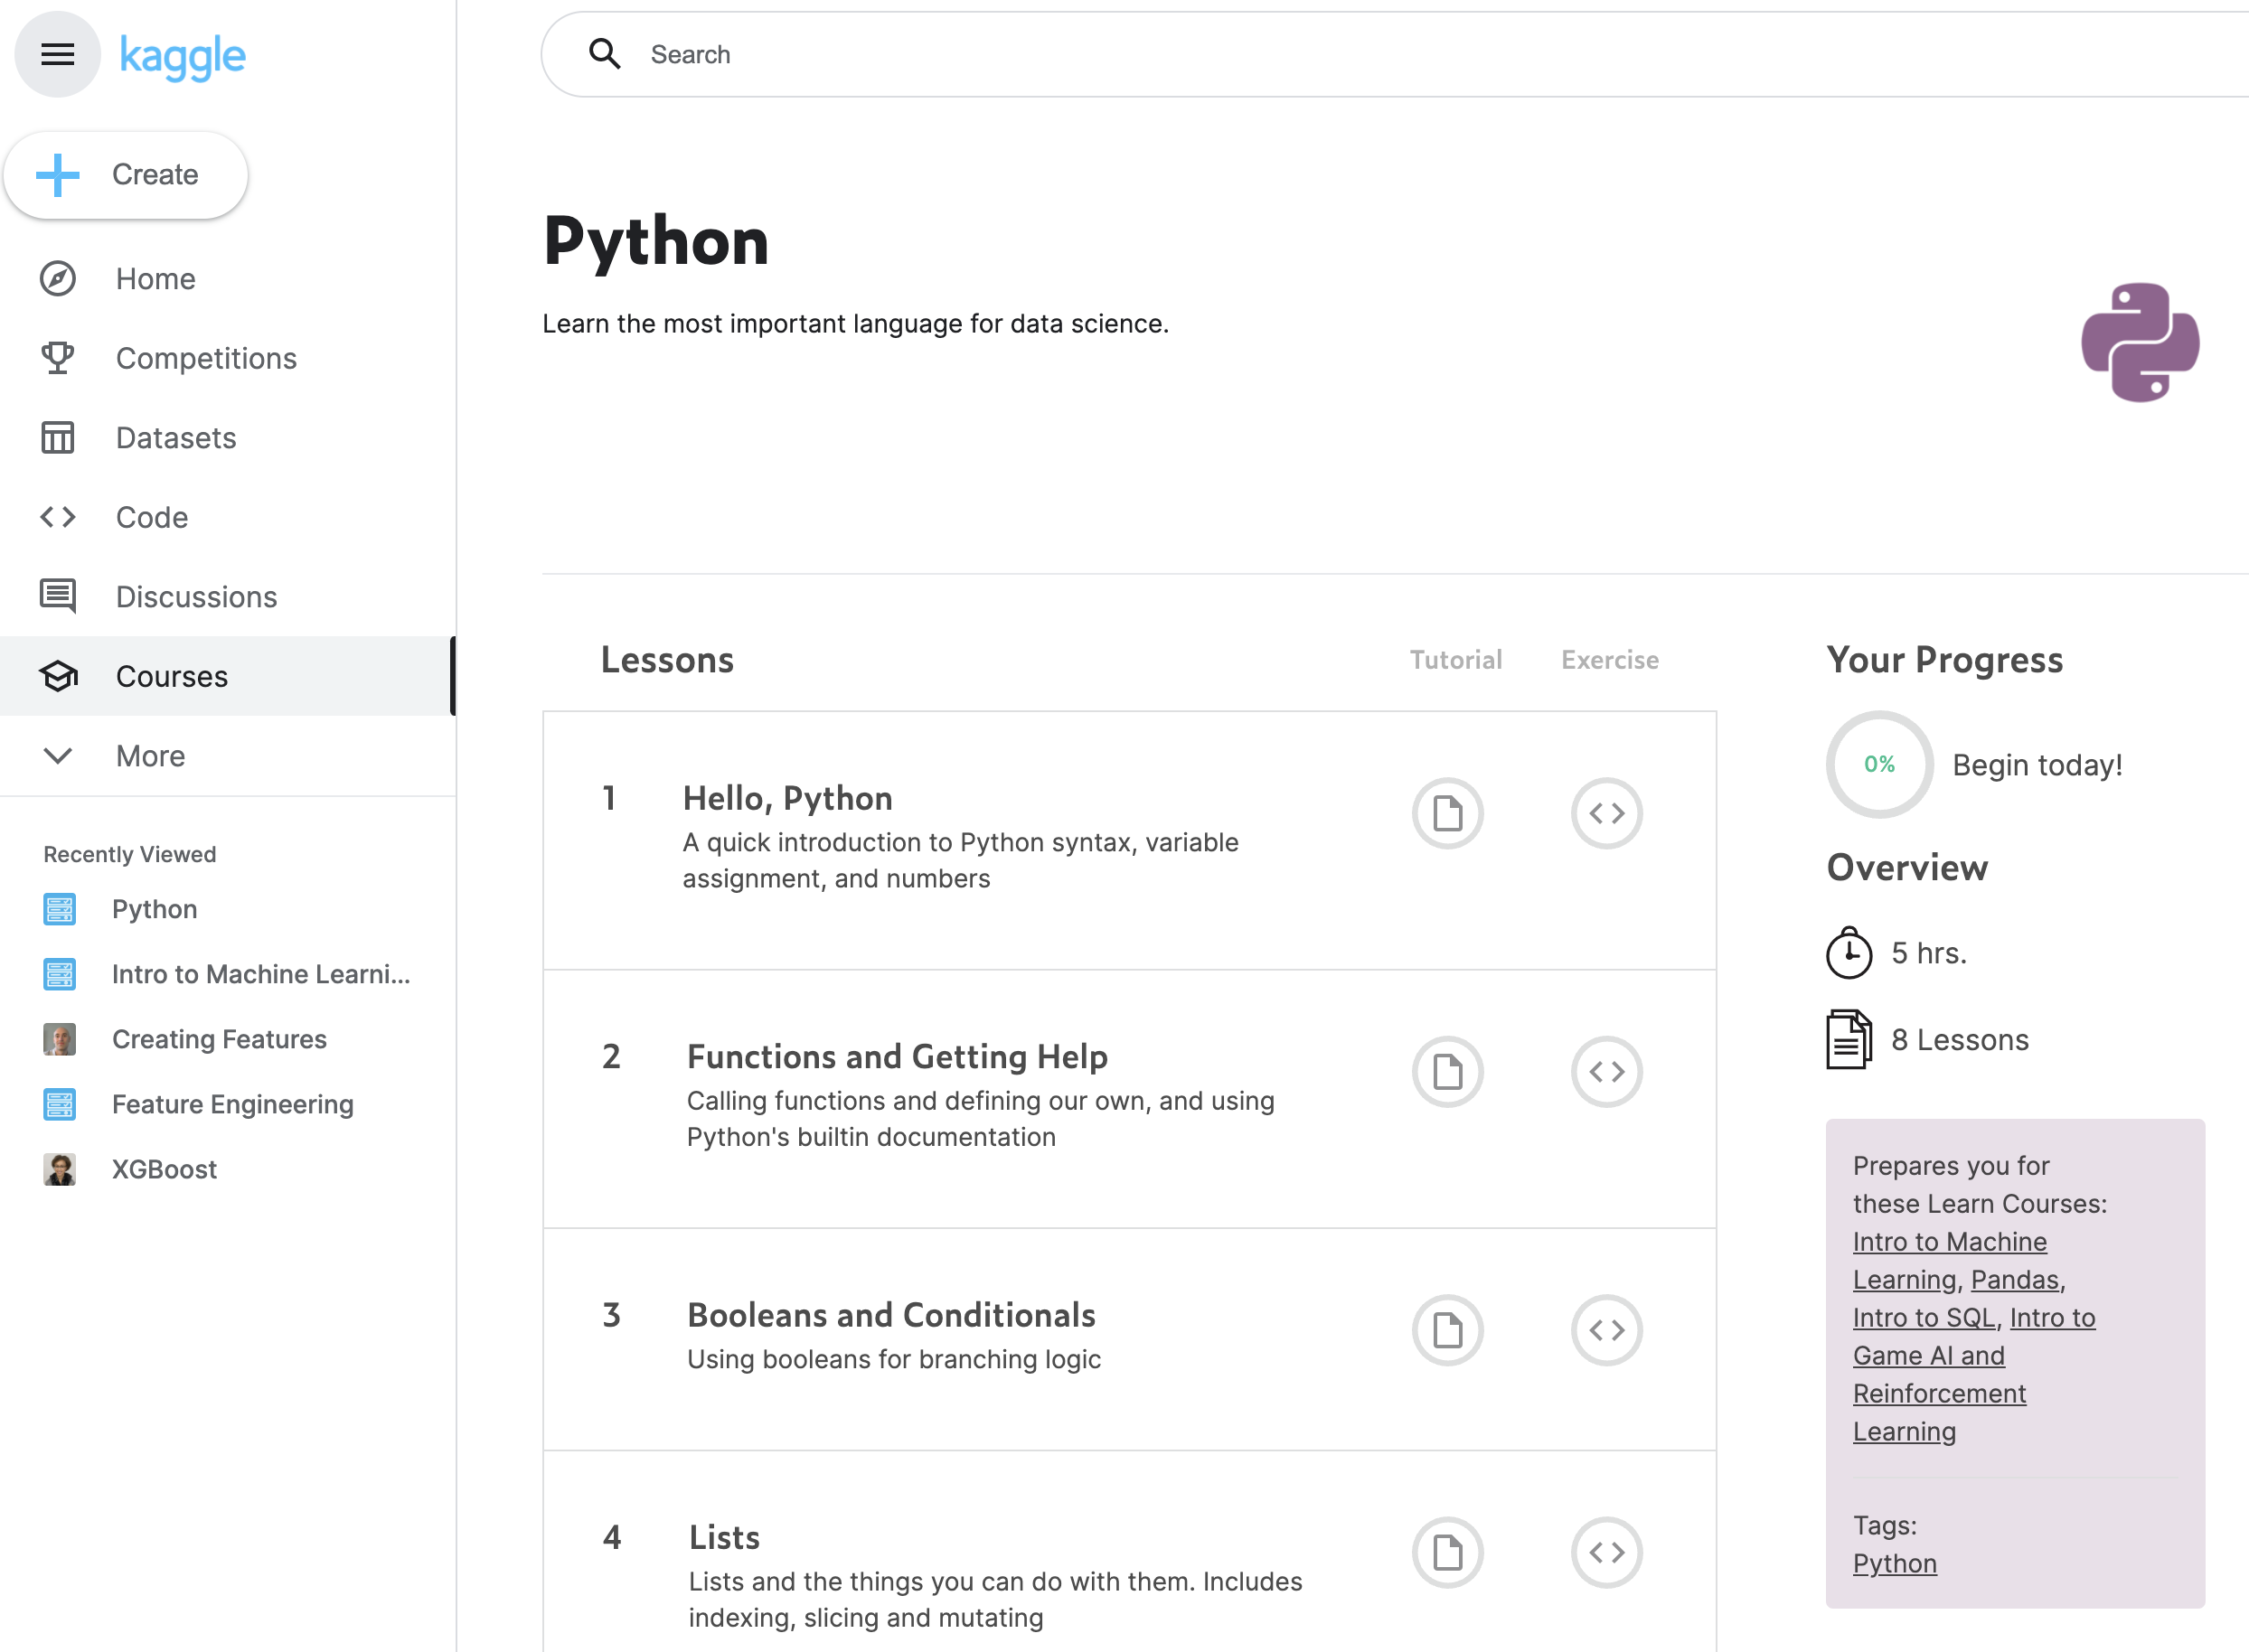
Prerequisites
I assumed you already know:
Basic of Statistics and Probability
Basic of Numerical Computing
Python Programming Language
You must be hungry to learn

Slide 5
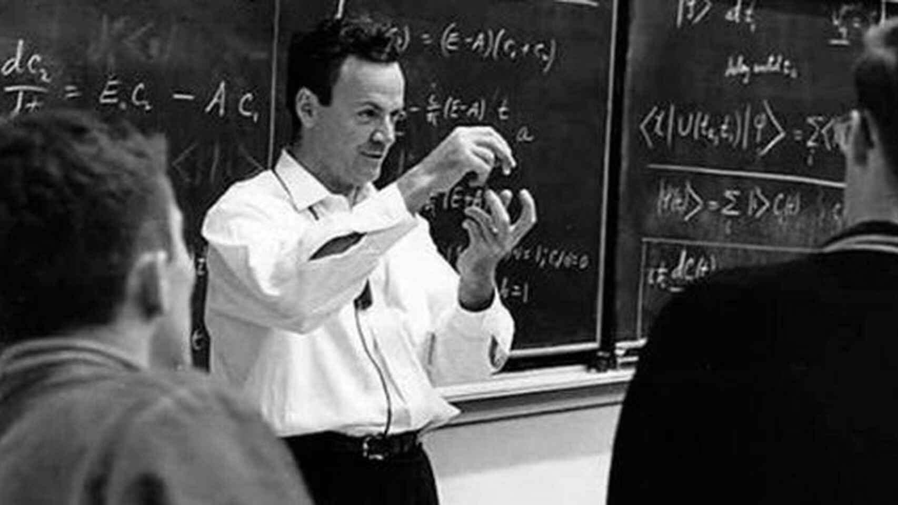
The FCP Way
The way of “scientists and engineers”:
Fundamental: The math
Conceptual: The Abstraction
Practical: The Skills
This course:
Fundamental: Textbooks
Conceptual: Zoom class (Saturday 09.30 -11.00)
Practical: Hacking on Google Collab and Kaggle
In Memory of Richard Feynman

Slide 6
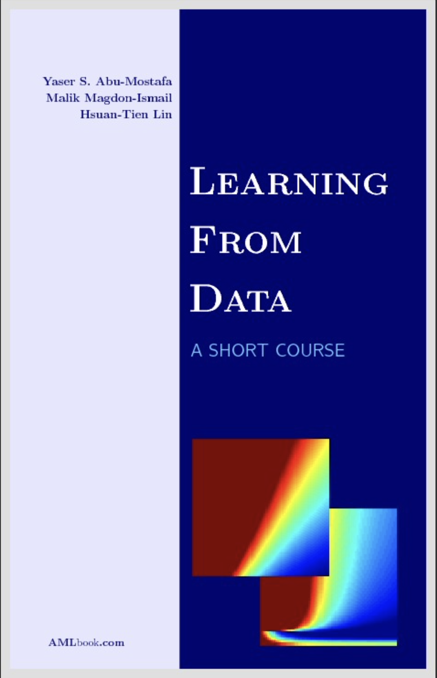
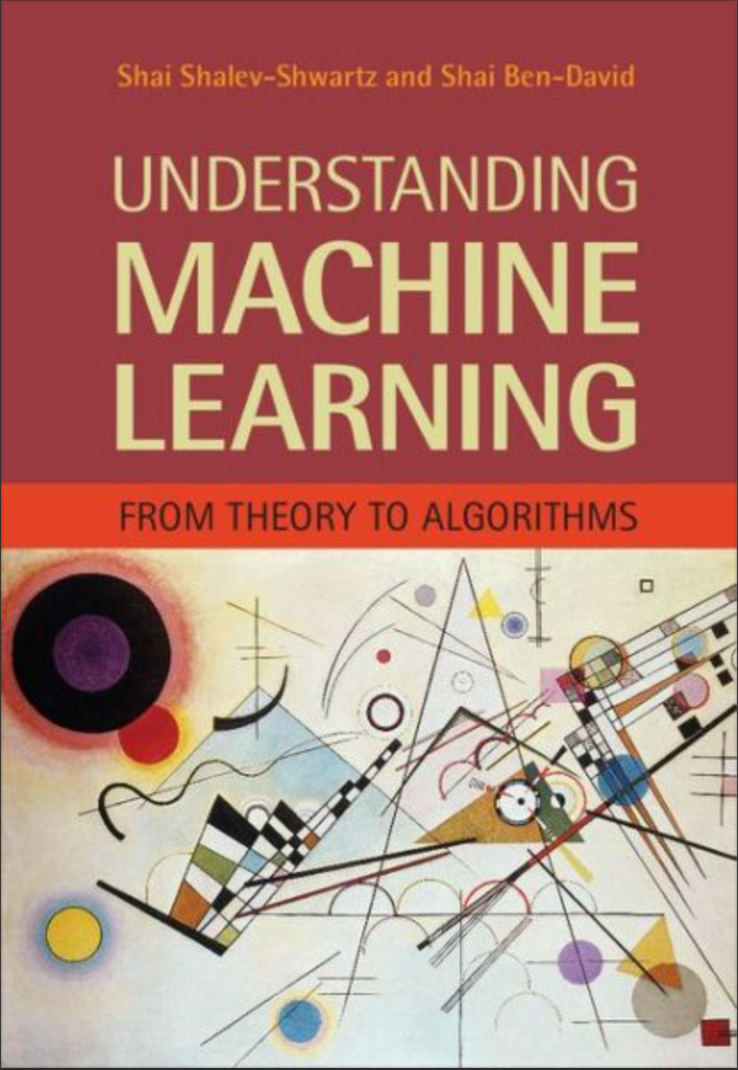
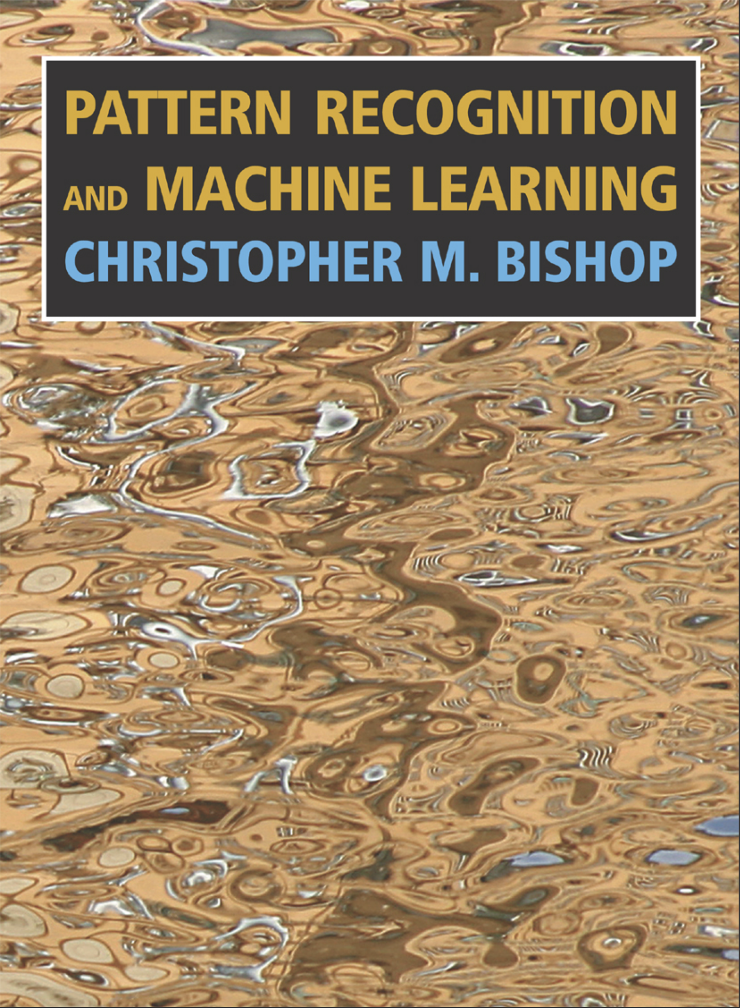
Textbooks
All course materials is posted here
This course is inspired by those books and you will have reading tasks!

Slide 7
Our Syllabus
W1: The Machine Learning Problem
W2: The Linear Models
W3: Decision Trees and Nearest Neighbor
W4: Support Vector Machine
W5: Features Engineering
W6: Optimization Algorithms
W7: Multi-Layer Perceptrons
W8: Deep Feed-forward Neural Networks
W9: Convolutional Neural Networks
W10: Recurrent Neural Networks (GRU and LSTM)
W11: Attention Mechanisms and Transformer
W12: Generative Adversarial Networks
W13: Applications on Computer Vision
W14: Applications on Natural Language Processing

Slide 8
Logistics
Attendance: If you think you are smart enough, you can skip the online classroom!
Classroom: 1.30 hours every Saturday, 09.30-11.00
Homework: “Code Hacking and Textbook Reading” but I will not have time to review
Discussion: 1 hour every Tuesday, 19.00 – 20.00
Mid and Final Exam: You will be given ML and DL projects, similar to homework!
Software/Tools: Scikit-Learn, Google Collab, and PyTorch

Slide 9
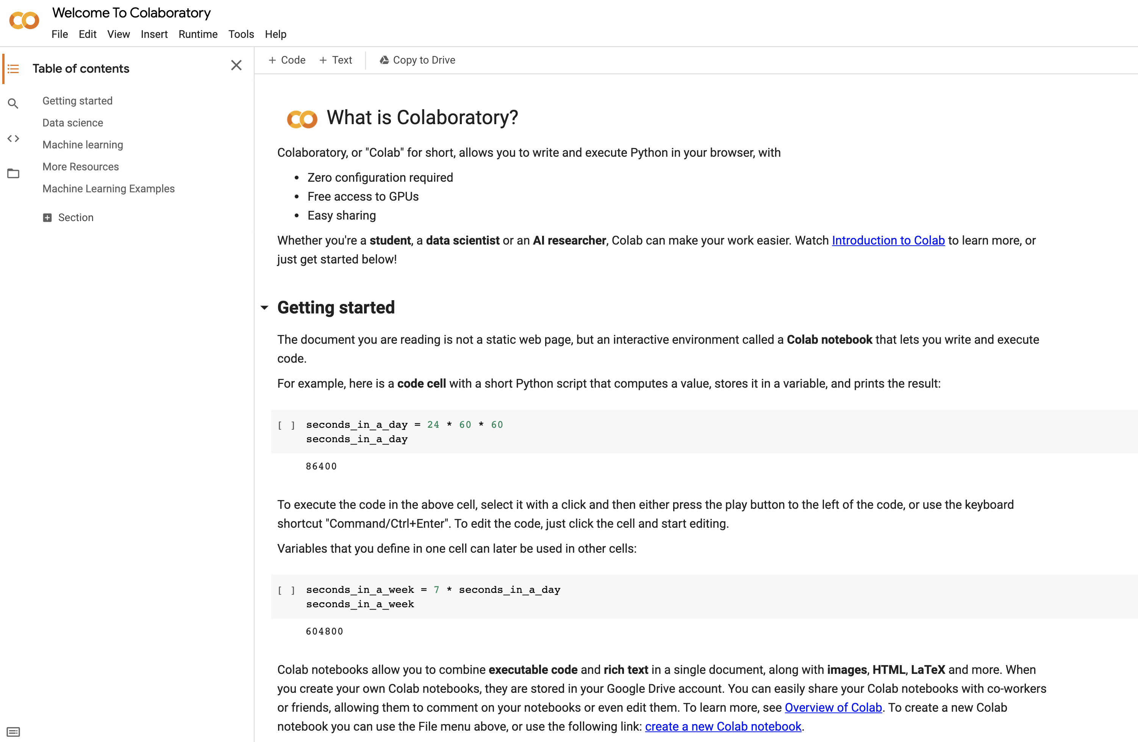
Your Call to Action
Register to Kaggle.com
Make Your Git Repository
Learn Python Programming at Kaggle
Learn To Use Google Collaboratory
See you next Saturday

